Slide 1
Chapter 7a
Potential Energy
and
Energy conservation

Slide 2
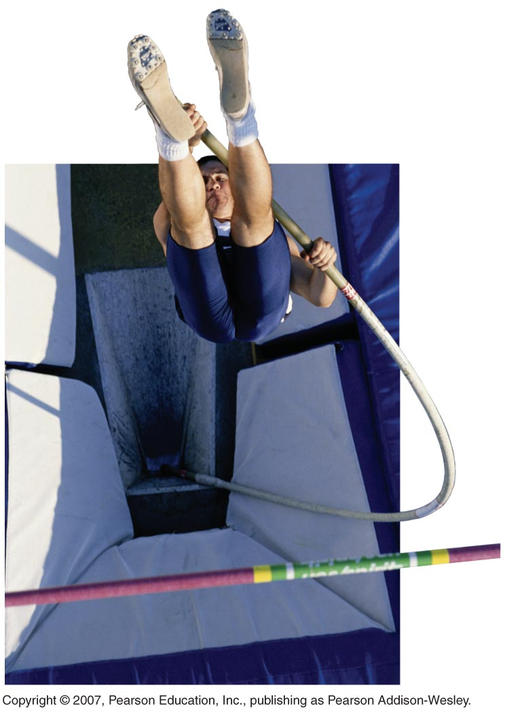

Chapter 7
Energy
Topics:
Important forms of energy
How energy can be transformed and transferred
Definition of work
Concepts of kinetic, potential, and thermal energy
The law of conservation of energy
Elastic collisions
Sample question:
When flexible poles became available for pole vaulting, athletes were able to clear much higher bars. How can we explain this using energy concepts?
Slide 10-1

Slide 3
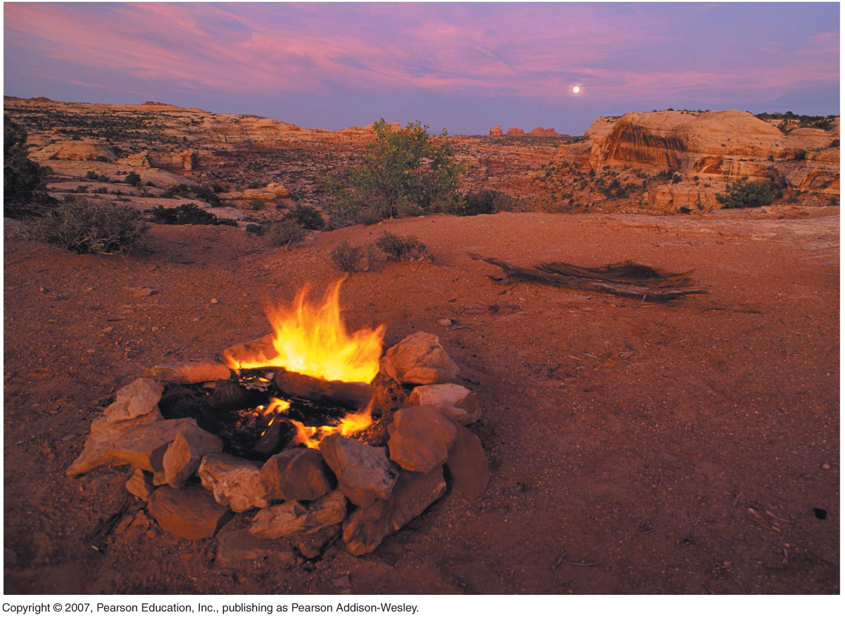
Looking Back: What You Already Know
From this class:
We will solve conservation of energy problems much like conservation of momentum problems, looking at a system before and after an interaction or change.
Understanding energy will draw on your understanding of 1D motion and rotational motion.
From previous classes:
Energy comes in different forms.
Energy can’t be created or destroyed.
Energy can be changed from one form to another.
Slide 10-8

Slide 4
A Natural Money called energy
Energy has many different forms:
Gravitational Energy
Kinetic Energy
Heat Energy
Elastic Energy
Electrical Energy
Chemical Energy
Radiant Energy
Nuclear Energy
Mass Energy

Slide 5
Forms of Energy
Mechanical Energy
Thermal Energy
Other forms include
Slide 10-10

Slide 6
If we total up all of these forms of energy, it will not change except for energy going in and out.
Energy can not be created nor destroyed, it can be transformed from one form to another.

Slide 7
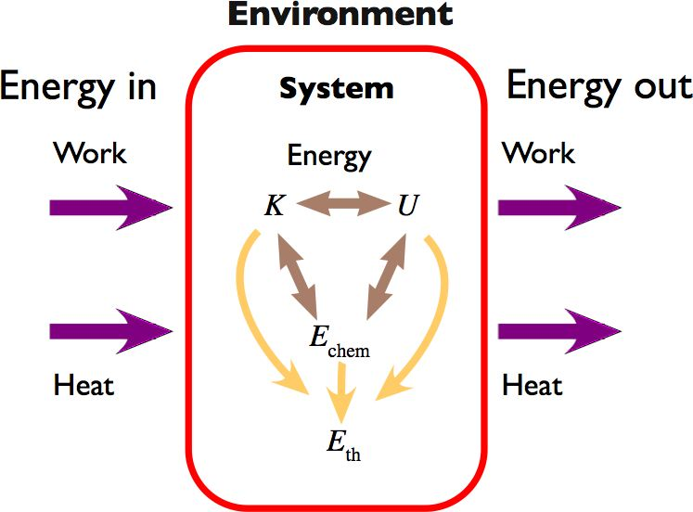
The Basic Energy Model
Slide 10-11

Slide 8
Kinetic Energy and Gravitational Potential Energy
Kinetic energy is an energy of motion. It depends on the mass and the velocity of the object.
Kinetic energy is a scalar, and does not depend on the direction of motion. Kinetic energy is always positive.
Unit: 1 joule = 1kg m²/s²

Slide 9
Gravitational Potential Energy
Gravitational Potential energy depends on an object’s position:
This energy is simply called potential energy when there is no ambiguity.
Since it is up to us to define a coordinate system, what we really care for is ΔU, or the change in potential energy for an object.

Slide 10
Consider a ball thrown upward with an initial velocity V₀. If the force due to gravity is the only force acting on the ball:

Slide 11
On the way up, ΔK is a loss, and ΔUg is a gain. On the way down, ΔK is a gain and ΔUg is a loss.
So the sum of the kinetic and potential energy at any instant is constant. K+U is always the same if the system is isolated and only conservative forces are acting within the system.
K+U is called the total Mechanical Energy E.

Slide 12
In an isolated, conservative system:

Slide 13
Energy bar charts:
Look at figure 10.6 for a pebble tossed in the air.
+
0
+
=
+
Ki
+
Ui
=
Kf
+
Uf
-

Slide 14
Consider a box of mass m sliding along a frictionless surface.
v
N
Δs
θ
Δy
w
θ

Slide 15
We have:

Slide 18
So:
For a particle moving along any frictionless surface, regardless of the shape.

Slide 19
Total mechanical energy of a system is defined as the sum of the kinetic energy of all the particles in the system and the total potential energy stored in the system.

Slide 20
The total mechanical energy of a system does not change as it moves under the influence of gravity.

Slide 21
Example 1:
A 4 kg mass is whirled in a vertical circle on the end of a 5m length of string. Its speed as it reaches point C is 10 m/s. Assume the system is conservative.
Find the speed of the mass at point B
Find its speed at point A
Find the tension in the string when the mass is at B.
C
R=5m
53
A
h = 0
h
B

Slide 22
Restoring Forces and Hooke’s law
Restoring Force: Force that restores a system to an equilibrium position.
Elastic system: Any system that exhibits restoring forces
Example: Springs, rubber bands, anything that stretches, flexes, bends or twists can be called elastic

Slide 23
Look at a spring (prototype of elasticity)
- Equilibrium length: Lo
- If stretched to length L, how hard does it pull back?
L₀
L

Slide 24
The attached mass is in static equilibrium so:
F_{sp}
W

Slide 25
We obtain:F_{sp} = k Δs
Large k: needs large pull to stretch: stiff spring
Small k: easily stretched with small force: soft spring
F
Δs=L-L0

Slide 26
Hooke’s law
Compression: Δs>0, F<0
Stretch: Δs<0, F>0
Equilibrium: Δs=0, F=0
So: (F_{sp})_{s} = -kΔs
Hooke’s law
Δs= s-s₀ =displacement of end of spring from equilibrium
Equilibrium

Slide 27
Elastic Potential Energy
- A spring exerts a variable force
- The force is zero if L=L₀ and it increases as the stretching length increases
- The natural motion of a mass on a string is oscillations
- A compressed spring has stored energy that can be translated into K.E.
Let us look at a ball attached to a spring.

Slide 28
For the ball:
v_{i}
v_{f}
s_{i}
s_{f}

Slide 30
This gives us:

Slide 31
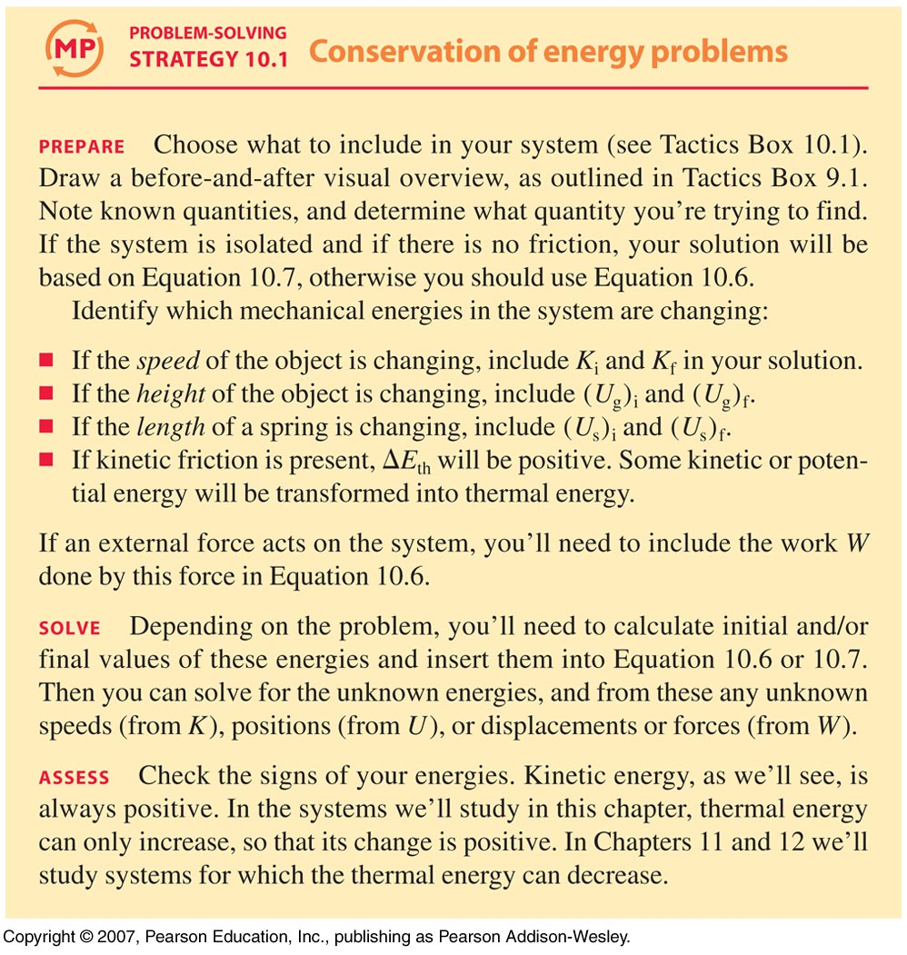
Solving Problems
Slide 10-22

Slide 32
Example 2
A skier is moving down a slope at a constant speed. What energy transformation is taking place?
A.
B.
C.
D.
E.
Slide 10-12
Notes:
Answer: B

Slide 33
Answer
A skier is moving down a slope at a constant speed. What energy transformation is taking place?
B.
Slide 10-13
Notes:
Answer: B

Slide 34

Example 3
A child is on a playground swing, motionless at the highest point of his arc. As he swings back down to the lowest point of his motion, what energy transformation is taking place?
A.
B.
C.
D.
E.
Slide 10-14
Notes:
Answer: D

Slide 35
Answer
A child is on a playground swing, motionless at the highest point of his arc. As he swings back down to the lowest point of his motion, what energy transformation is taking place?
D.
Slide 10-15
Notes:
Answer: D

Slide 36
Example 4
A car sits at rest at the top of a hill. A small push sends it rolling down a hill. After its height has dropped by 5.0 m, it is moving at a good clip. Write down the equation for conservation of energy, noting the choice of system, the initial and final states, and what energy transformation has taken place.
Slide 10-17

Slide 37
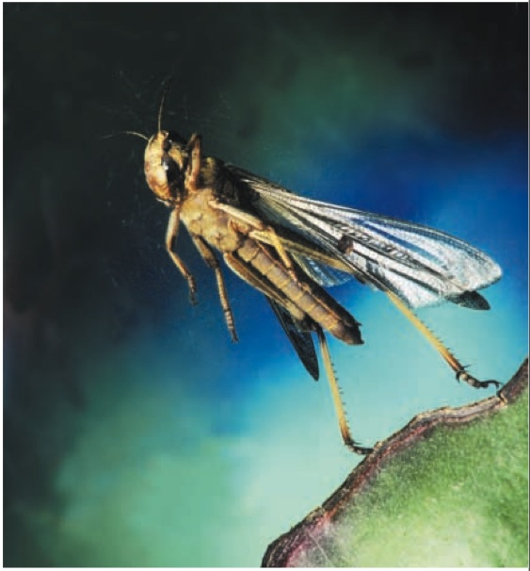
Example 5
A 2.0 g desert locust can achieve a takeoff speed of 3.6 m/s (comparable to the best human jumpers) by using energy stored in an internal “spring” near the knee joint.
When the locust jumps, what energy transformation takes place?
What is the minimum amount of energy stored in the internal spring?
If the locust were to make a vertical leap, how high could it jump? Ignore air resistance and use conservation of energy concepts to solve this problem.
If 50% of the initial kinetic energy is transformed to thermal energy because of air resistance, how high will the locust jump?
Slide 10-24

Slide 38
Example 6
A 200 g block on a frictionless surface is pushed against a spring with spring constant 500 N/m, compressing the spring by 2.0 cm. When the block is released, at what speed does it shoot away from the spring?
Slide 10-23

Slide 39
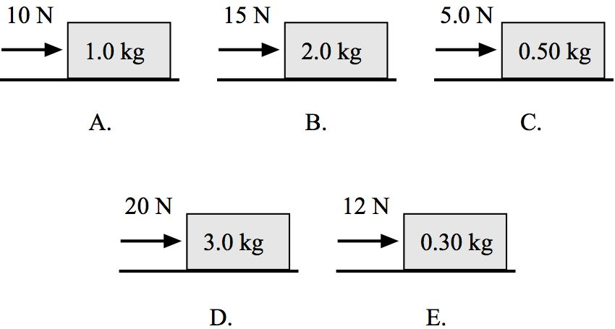
Example 7:
Each of the 1.0 kg boxes starts at rest and is then pushed for 2.0 m across a level, frictionless floor by a rope with the noted force. Which box has the highest final speed?
Slide 10-33
Notes:
Answer: E

Slide 40
Answer
Each of the 1.0 kg boxes starts at rest and is then pushed for 2.0 m across a level, frictionless floor by a rope with the noted force. Which box has the highest final speed?
Slide 10-34
Notes:
Answer: E

Slide 41
Example 8:
Each of the 1.0 kg boxes starts at rest and is then pushed for 2.0 m across a level, frictionless floor by a rope with the noted force. Which box has the lowest final speed?
Slide 10-35
Notes:
Answer: D

Slide 42
Answer
Each of the 1.0 kg boxes starts at rest and is then pushed for 2.0 m across a level, frictionless floor by a rope with the noted force. Which box has the lowest final speed?
Slide 10-36
Notes:
Answer: D

Slide 43
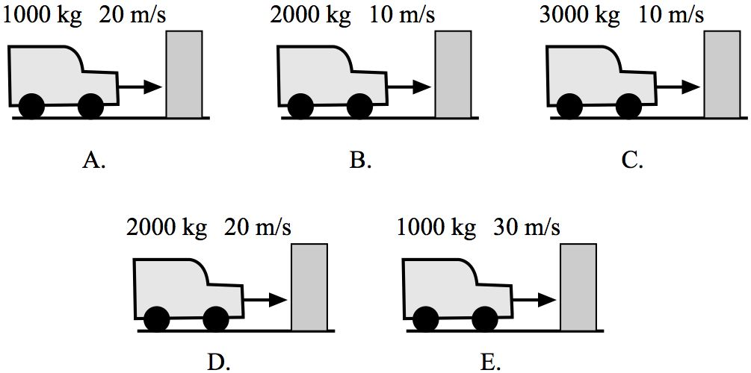
Example 9:
Trucks with the noted masses moving at the noted speeds crash into barriers that bring them to rest with a constant force. Which truck compresses the barrier by the largest distance?
Slide 10-37
Notes:
Answer: E

Slide 44
Answer
Trucks with the noted masses moving at the noted speeds crash into barriers that bring them to rest with a constant force. Which truck compresses the barrier by the largest distance?
Slide 10-38
Notes:
Answer: E

Slide 45
Example 10:
Trucks with the noted masses moving at the noted speeds crash into barriers that bring them to rest with a constant force. Which truck compresses the barrier by the smallest distance?
Slide 10-39
Notes:
Answer: B

Slide 46
Answer
Trucks with the noted masses moving at the noted speeds crash into barriers that bring them to rest with a constant force. Which truck compresses the barrier by the smallest distance?
Slide 10-40
Notes:
Answer: B

Slide 47
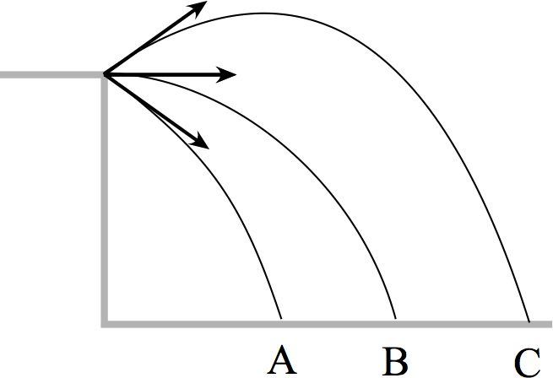
Example 11:
Three balls are thrown off a cliff with the same speed, but in different directions. Which ball has the greatest speed just before it hits the ground?
Ball A
Ball B
Ball C
All balls have the same speed
Slide 10-41
Notes:
Answer: D

Slide 48
Answer
Three balls are thrown off a cliff with the same speed, but in different directions. Which ball has the greatest speed just before it hits the ground?
All balls have the same speed
Slide 10-42
Notes:
Answer: D

Slide 49
Example 12:
A 20-cm-long spring is attached to a wall. When pulled horizontally with a force of 100 N, the spring stretches to a length of 22 cm. What is the value of the spring constant?
5000 N/m
500 N/m
454 N/m
Slide 10-43
Notes:
Answer: C

Slide 50
Answer
A 20-cm-long spring is attached to a wall. When pulled horizontally with a force of 100 N, the spring stretches to a length of 22 cm. What is the value of the spring constant?
454 N/m
Slide 10-44
Notes:
Answer: C

Slide 51
Example 13:
I swing a ball around my head at constant speed in a circle with circumference 3 m. What is the work done on the ball by the 10 N tension force in the string during one revolution of the ball?
30 J
20 J
10 J
0 J
Slide 10-45
Notes:
Answer: D

Slide 52
Answer
I swing a ball around my head at constant speed in a circle with circumference 3 m. What is the work done on the ball by the 10 N tension force in the string during one revolution of the ball?
0 J
Slide 10-46
Notes:
Answer: D

